Slide 1


Noida Institute of Engineering and Technology, Greater Noida
Medium access sublayer &
Data Link Layer
Unit: 2
Computer Networks
ACSE0502
B Tech 6th Sem

Slide 2
Contents
Evaluation Scheme
Syllabus
Branch wise syllabus
Course Objective
Course Outcome
Program Outcome
CO-PO Mapping
PSO
CO- PSO Mapping
PEO
Result analysis
Paper template
Prerequisites
Introduction to subject
Unit objective
MAC
Multiple access protocols
Controlled access protocols
Random Access Protocols
Protocols
Topic objective & Recap of previous Topic

Slide 3
Contents
Error Control
Error Detection
Error Correction
IEEE standards
Topic objective & Recap of previous topic
Video Links
Quiz
Weekly assignment
MCQ
Old Question papers
Expected Questions in University exams
Summary
Reference

Slide 4

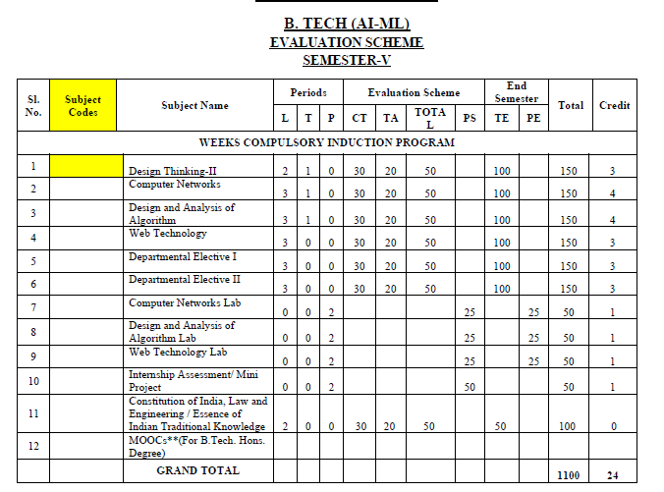
Evaluation Scheme

Slide 5
Syllabus
Unit | Topic
I | Introductory Concepts: Goals and applications of networks, Categories of networks, Organization of the Internet, ISP, Network structure and architecture (layering, services, protocols and standards), The OSI reference model, TCP/IP protocol suite, Network devices and components. Physical Layer: Network topology design, Types of connections, Transmission media, Signal transmission and encoding, Network performance and transmission impairments, Switching techniques and multiplexing.
II | Link layer: Framing, Error Detection and Correction, Flow control (Elementary Data Link Protocols, Sliding Window protocols). Medium Access Control and Local Area Networks: Channel allocation, Multiple access protocols, LAN standards, Link layer switches & bridges (learning bridge and spanning tree algorithms).
III | Network Layer: Point-to-point networks, Logical addressing, Basic internetworking (IP, CIDR, ARP, RARP, DHCP, ICMP), Routing, forwarding and delivery, Static and dynamic routing, Routing algorithms and protocols, Congestion control algorithms, IPv6.
IV | Transport Layer: Process-to-process delivery, Transport layer protocols (UDP and TCP), Multiplexing, Connection management, Flow control and retransmission, Window management, TCP Congestion control, Quality of service.
V | Application Layer: Domain Name System, World Wide Web and Hyper Text Transfer Protocol, Electronic mail, File Transfer Protocol, Remote login, Network management, Data compression, Cryptography – basic concepts.

Slide 6
Branch wise Applications
Resource Sharing
Server-Client model:
Communication Medium:
Access to remote information
Person-to-person communication
Electronic commerce
Cloud-based Applications
AI and Expert System
Neural Networks and parallel programming
Decision support and office automation systems etc.

Slide 7
Course Objective
To develop an understanding of
To understand computer networking basics.
To understand different components of computer networks.
To study and understand various protocols.
The standard models for the layered approach to communication between autonomous machines in a network.
To study and understand the main characteristics of data transmission across various physical link types.

Slide 8
Course Outcome
At the end of the course, the student will be able
Course Outcomes (CO) |  | Bloom’s Knowledge Level (KL)
C603.1 | Explain basic concepts, OSI reference model, services and role of each layer of OSI model and TCP/IP, networks devices and transmission media, Analog and digital data transmission | K1, K2
C603.2 | Apply channel allocation, framing, error and flow control techniques. | K3
C603.3 | Describe the functions of Network Layer i.e. Logical addressing, subnetting & Routing Mechanism | K2, K3
C603.4 | Explain the different Transport Layer function i.e. Port addressing, Connection Management, Error control and Flow control mechanism. | K2, K3
C603.5 | Explain the functions offered by session and presentation layer and their Implementation. | K2, K3
C603.6 | Explain the different protocols used at application layer i.e. HTTP, SNMP, SMTP, FTP, TELNET and VPN. | K2

Slide 9
Program Outcome
1. Engineering knowledge
2. Problem analysis
3. Design/development of solutions
4. Conduct investigations of complex problems
5. Modern tool usage
6. The engineer and society
7. Environment and sustainability
8. Ethics
9. Individual and team work
10. Communication
11. Project management and finance
12. Life-long learning

Slide 10
CO-PO Mapping
The highlighted text shows the mapping of course outcome with PO mapping of this unit
Computer Networks (KCS-603) |  |  |  |  |  |  |  |  | Year of Study: 2021-22
CO | PO1 | PO2 | PO3 | PO4 | PO5 | PO6 | PO7 | PO8 | PO9 | PO10 | PO11 | PO12
C603.1 | 3 | 2 | 3 | 2 | 1 | 1 |  |  |  |  | 2 | 3
C603.2 | 3 | 3 | 2 | 2 | 3 | 2 |  | 1 |  |  | 1 | 3
C603.3 | 3 | 2 | 1 |  | 1 | 2 |  | 1 | 2 |  | 1 | 3
C603.4 | 2 | 2 | 1 |  | 1 |  |  | 1 | 1 |  | 1 | 3
C603.5 | 2 | 2 | 2 |  | 1 |  |  |  |  |  | 1 | 3
C603.6 | 2 | 1 |  |  | 3 | 2 |  | 3 | 1 |  | 1 | 3

Slide 11
Program Specific Outcomes
PSO1: Work as a software developer, database administrator, tester or networking engineer for providing solutions to the real world and industrial problems.
PSO2:Apply core subjects of information technology related to data structure and algorithm, software engineering, web technology, operating system, database and networking to solve complex IT problems.
PSO3: Practice multi-disciplinary and modern computing techniques by lifelong learning to establish innovative career.
PSO4: Work in a team or individual to manage projects with ethical concern to be a successful employee or employer in IT industry.

Slide 12
CO-PSO Mapping
The highlighted text shows the mapping of course outcome with PSO mapping of this unit
CO | PSO1 | PSO2 | PSO3 | PSO4
C603.1 | 3 | 3 | 2 | 1
C603.2 | 3 | 3 | 2 | 1
C603.3 | 3 | 3 | 2 | 1
C603.4 | 3 | 3 | 1 | 1
C603.5 | 3 | 3 | 1 | 1
C603.6 | 3 | 3 | 1 | 1

Slide 13
Program Educational Objectives
PEO1: able to apply sound knowledge in the field of information technology to fulfill the needs of IT industry.
PEO2: able to design innovative and interdisciplinary systems through latest digital technologies.
PEO3: able to inculcate professional and social ethics, team work and leadership for serving the society.
PEO4: able to inculcate lifelong learning in the field of computing for successful career in organizations and R&D sectors.

Slide 14
Result Analysis
Computer Networks Result of 2020-21: 96.97%
Average Marks: 54.33

Slide 15
End Semester Question Paper Template
B TECH
(SEM-V) THEORY EXAMINATION 20__-20__
OBJECT ORIENTED SYSTEM DESIGN
Time: 3 Hours Total Marks: 100
Note: 1. Attempt all Sections. If require any missing data; then choose suitably.
SECTION A
Attempt all questions in brief. 2 x 10 = 20
Q.No. | Question | Marks | CO
1 |  | 2
2 |  | 2
. |  | .
10 |  | 2

Slide 16
End Semester Question Paper Templates
SECTION B
2. Attempt any three of the following: 3 x 10 = 30
SECTION C
3. Attempt any one part of the following: 1 x 10 = 10
Q.No. | Question | Marks | CO
1 |  | 10
2 |  | 10
. |  | .
5 |  | 10
Q.No. | Question | Marks | CO
1 |  | 10
2 |  | 10

Slide 17
End Semester Question Paper Templates
4. Attempt any one part of the following: 1 x 10 = 10
5. Attempt any one part of the following: 1 x 10 = 10
6. Attempt any one part of the following: 1 x 10 = 10
Q.No. | Question | Marks | CO
1 |  | 10
2 |  | 10
Q.No. | Question | Marks | CO
1 |  | 10
2 |  | 10
Q.No. | Question | Marks | CO
1 |  | 10
2 |  | 10

Slide 18
End Semester Question Paper Templates
7. Attempt any one part of the following: 1 x 10 = 10
Q.No. | Question | Marks | CO
1 |  | 10
2 |  | 10

Slide 19
Prerequisite
The student should have knowledge of
Networking
Layout of computer
Hardware
The basic knowledge of C

Slide 20
Brief Introduction to Subject
Computer network is a group of devices connected with each other through a transmission medium such as wires, cables etc.
These devices can be computers, printers, scanners, Fax machines etc.
The purpose of having computer network is to send and receive data stored in other devices over the network.

Slide 21
Medium access control sublayer(CO2)
Topic objective
Understand the Medium access sub layer of data link layer
Understand the Functions of MAC
Find out Channel allocation problem and
Various multiple access protocols

Slide 22
Medium access control sublayer(CO2)
It is responsible for flow control and multiplexing for transmission medium.
The Open System Interconnections (OSI) model is a layered networking framework that conceptualizes how communications should be done between heterogeneous systems.
The data link layer is divided into two sublayers −
The logical link control (LLC) sublayer
The medium access control (MAC) sublayer

Slide 23
Functions of MAC Layer
It provides an abstraction of the physical layer to the LLC and upper layers of the OSI network.
It is responsible for encapsulating frames so that they are suitable for transmission via the physical medium.
It resolves the addressing of source station as well as the destination station, or groups of destination stations.
It performs multiple access resolutions when more than one data frame is to be transmitted. It determines the channel access methods for transmission.
It also performs collision resolution and initiating retransmission in case of collisions.
It generates the frame check sequences and thus contributes to protection against transmission errors.

Slide 24
MAC
MAC address or media access control address is a unique identifier allotted to a network interface controller (NIC) of a device.
It is used as a network address for data transmission within a network segment like Ethernet, Wi-Fi, and Bluetooth.
This layer determines who goes next on a multi-access channel
MAC protocols are mechanisms that allow users to access a common medium or channel.
Aloha, slotted Aloha, and Carrier Sense Multiple Access protocols are used
This layer is important in LAN’s
Channel allocation problem
Static channel
Dynamic channel allocation

Slide 25
Static channel Allocation(CO5)
For fixed channel and traffic from N users
Divide up bandwidth using FDM, TDM, CDMA, etc. − FDM and TDM
problematic with large no. of senders or bursty traffic
This static allocation performs poorly for bursty traffic
Most data transmissions are inherently bursty
Allocation to any given user will sometimes go unused = wasteful

Slide 26
Dynamic channel Allocation(CO5)
Dynamic allocation gives the channel to a user when they need it.
Potentially N times as efficient for N users.
Various schemes
Independent traffic Often not a good model, but permits analysis
Single channel No external way to coordinate senders
Observable collisions Needed for reliability; mechanisms vary
(2+ sending simultaneously)
Continuous or Slotting (time divided up into discrete
slotted time intervals) may improve performance
Carrier sense Can improve performance if available
no carrier sense

Slide 27
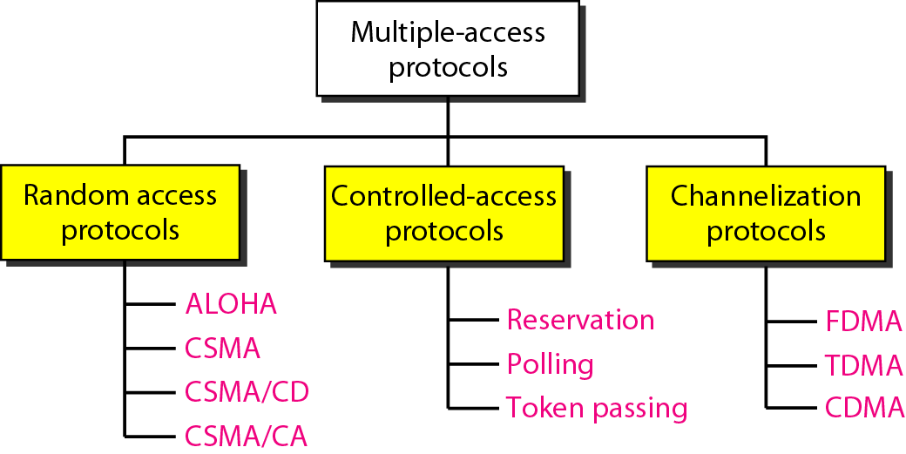
Multiple Access Protocols(CO2)
Two basic strategies for channel acquisition in a broadcast network:
1. Contention (e.g., Aloha, CSMA) – preferable for low load because of its low delay characteristics
2. Collision Free Protocols – preferable at high load

Slide 28
Random access protocols
random access or contention methods
no station is superior to another station and none is assigned the control over another.
No station permits, or does not permit, another station to send.
At each instance, a station that has data to send uses a procedure defined by the protocol to make a decision on whether or not to send.

Slide 29
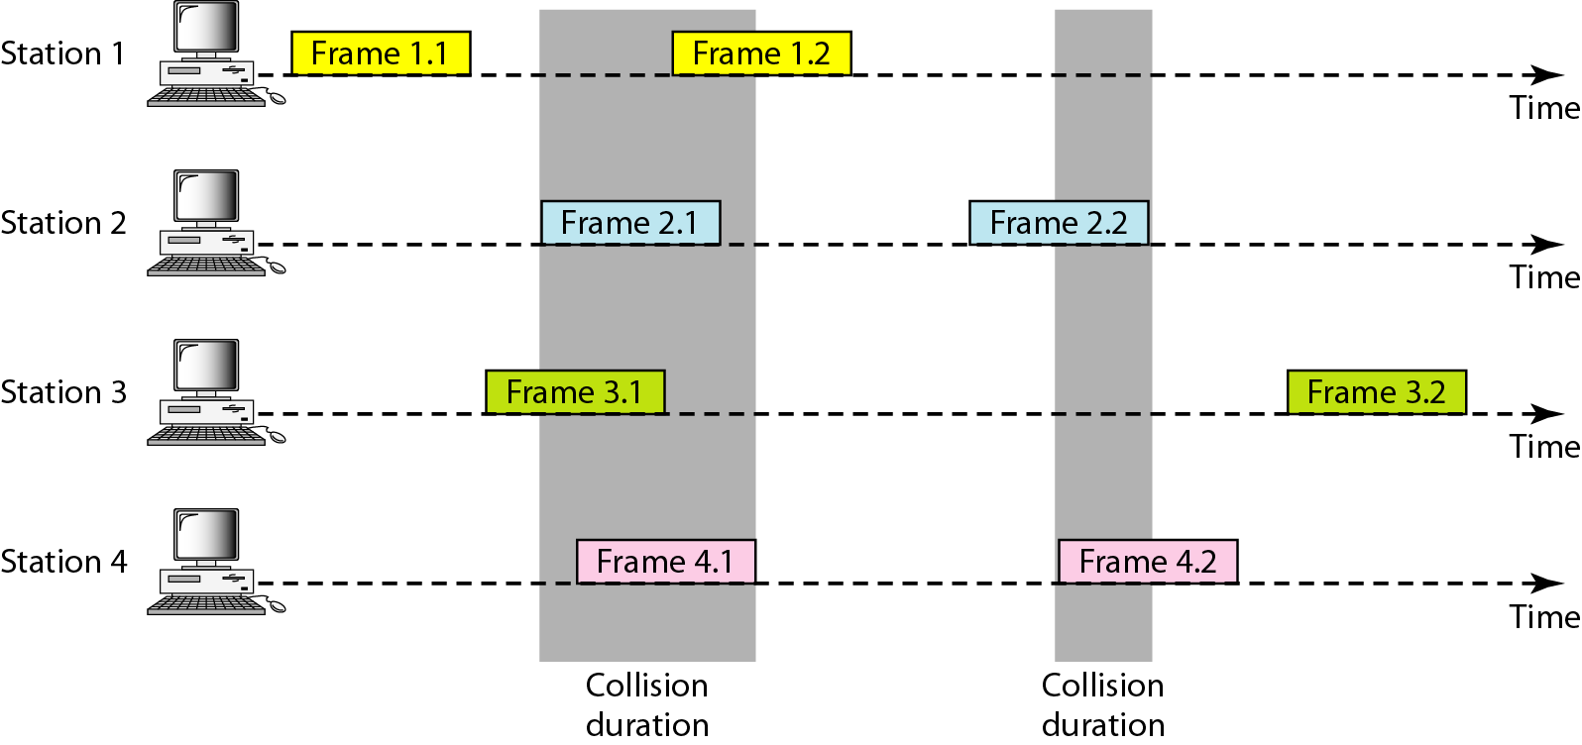
Pure Aloha
Frames are transmitted at completely arbitrary times

Slide 30
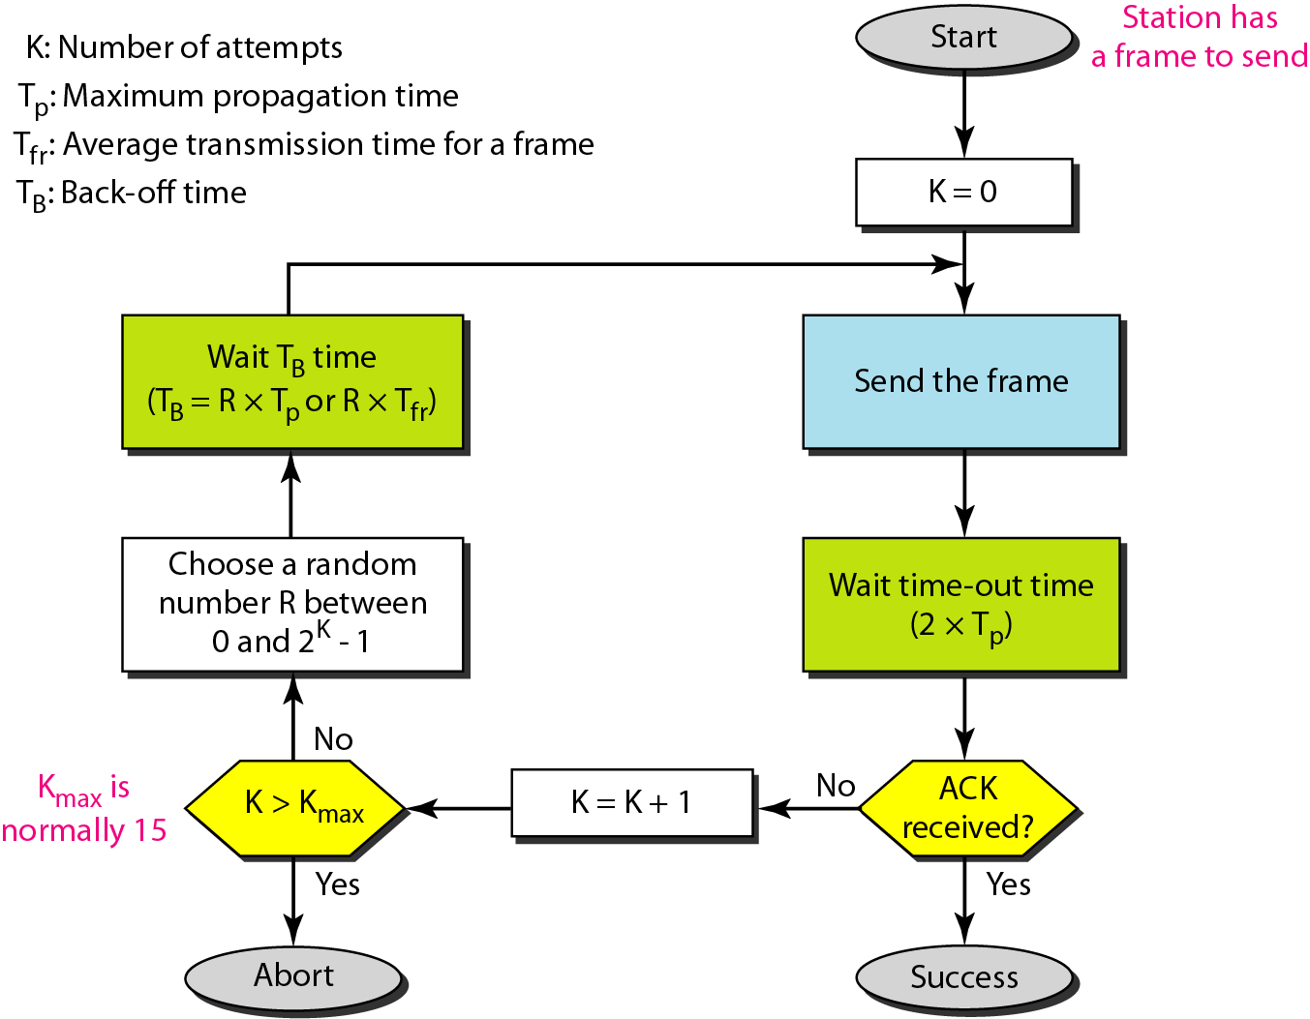
Procedure for pure Aloha
The throughput for pure ALOHA is S = G × e ^{−2G} .
The maximum throughput
S_{max} = 0.184 when G= (1/2).

Slide 31
Slotted Aloha
Time in uniform slot equal to frame transmission time
Need central clock for synchronisation
Transmission begins at slot boundary
The throughput for slotted ALOHA is S = G × e^{−G} .
The maximum throughput S_{max} = 0.368 when G = 1.

Slide 32
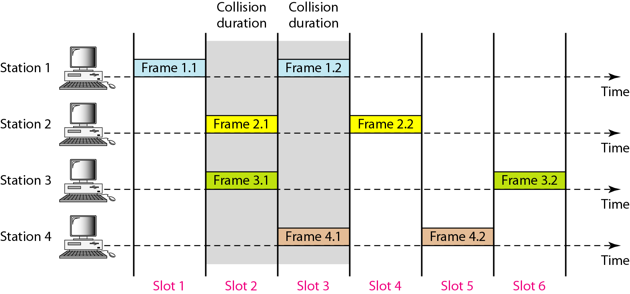
Slotted Aloha

Slide 33
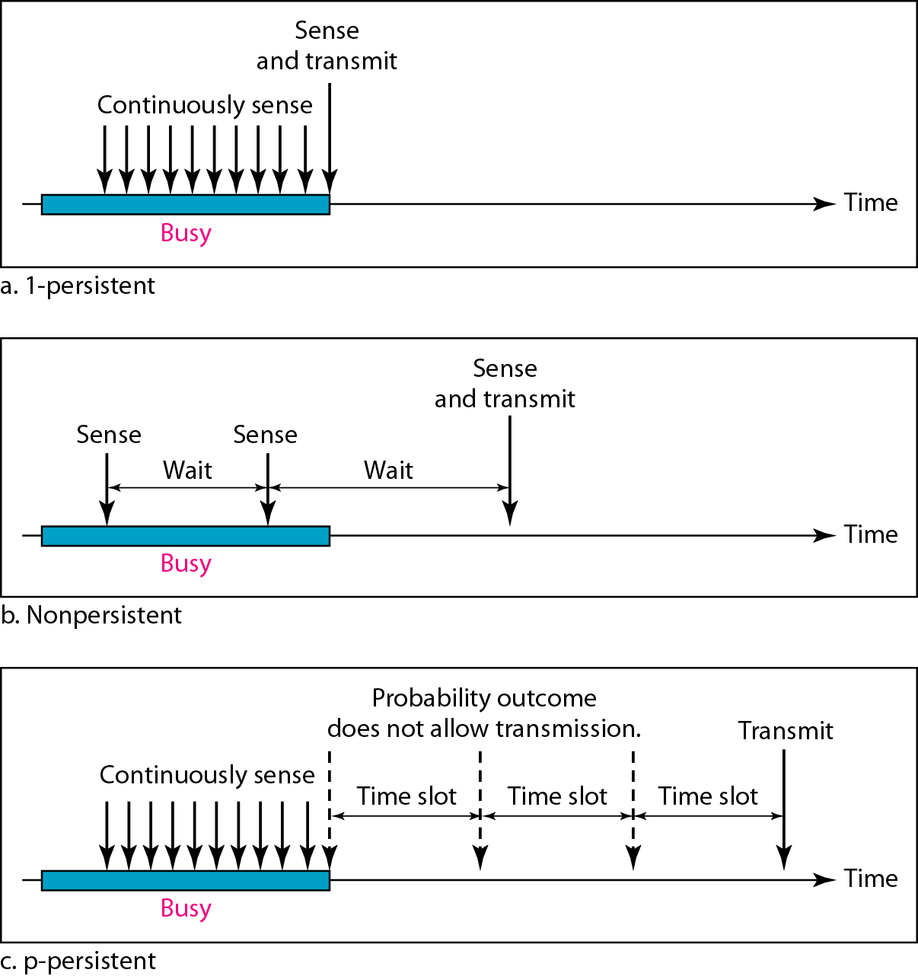
CSMA(CO2)
Carrier Sense Multiple Access (CSMA)
improves on ALOHA by sensing the channel
Variations (within CSMA) on what to do
if the channel is busy:
1-persistent
Non persistent
P-persistent

Slide 34
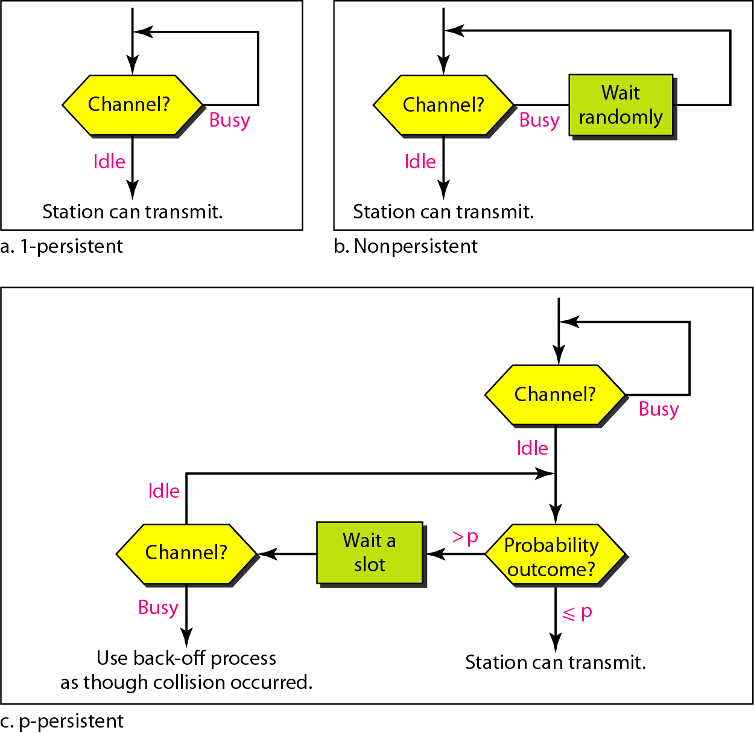
CSMA

Slide 35
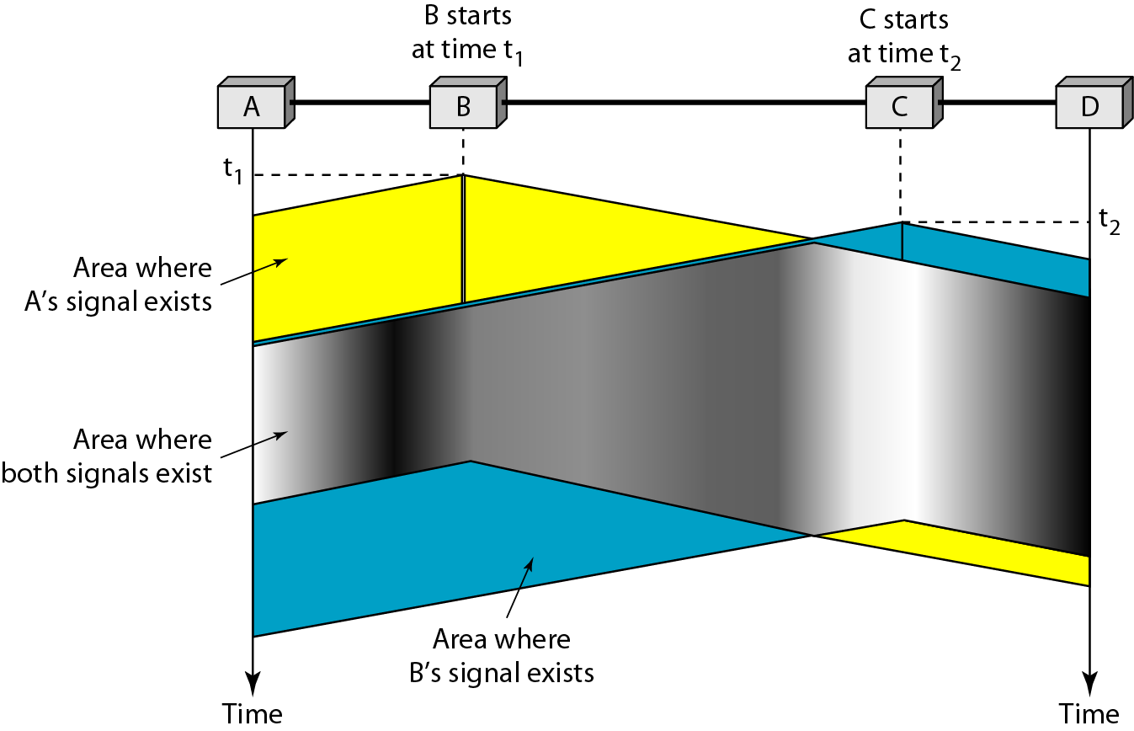
CSMA

Slide 36
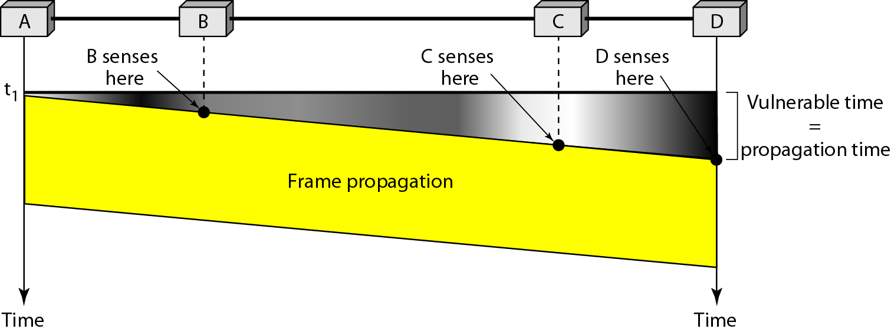
Vulnerable time in CSMA

Slide 37
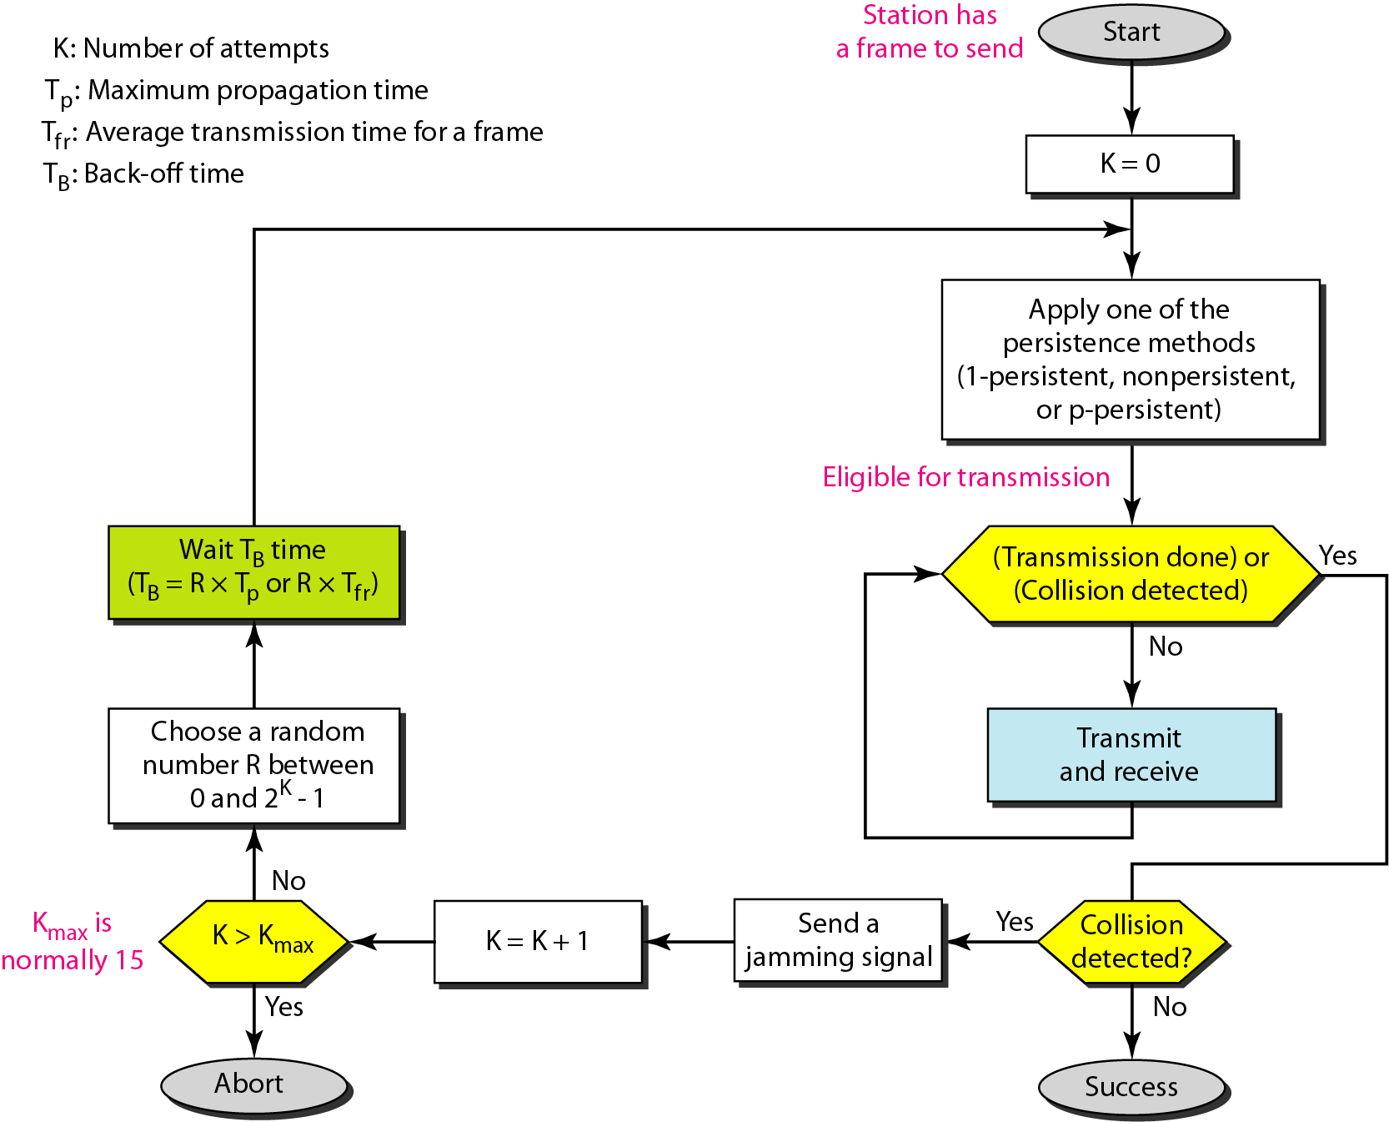
CSMA/CD
Step 1: Check if the sender is ready for transmitting data packets.
Step 2: Check if the transmission link is idle?
Step 3: Transmit the data & check for collisions.
Step 4: If no collision was detected in propagation, the sender completes its frame transmission and resets the counters.

Slide 38
CSMA/CA
Three type of strategies:
InterFrame Space (IFS) – When a station finds the channel busy, it waits for a period of time called IFS time. IFS can also be used to define the priority of a station or a frame. Higher the IFS lower is the priority.
Contention Window – It is the amount of time divided into slots.A station which is ready to send frames chooses random number of slots as wait time.
Acknowledgements – The positive acknowledgements and time-out timer can help guarantee a successful transmission of the frame.

Slide 39
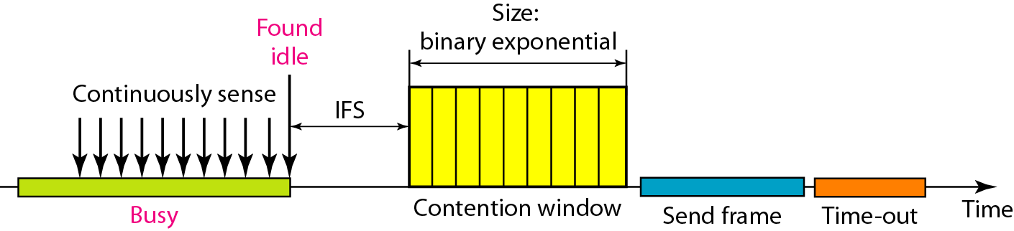
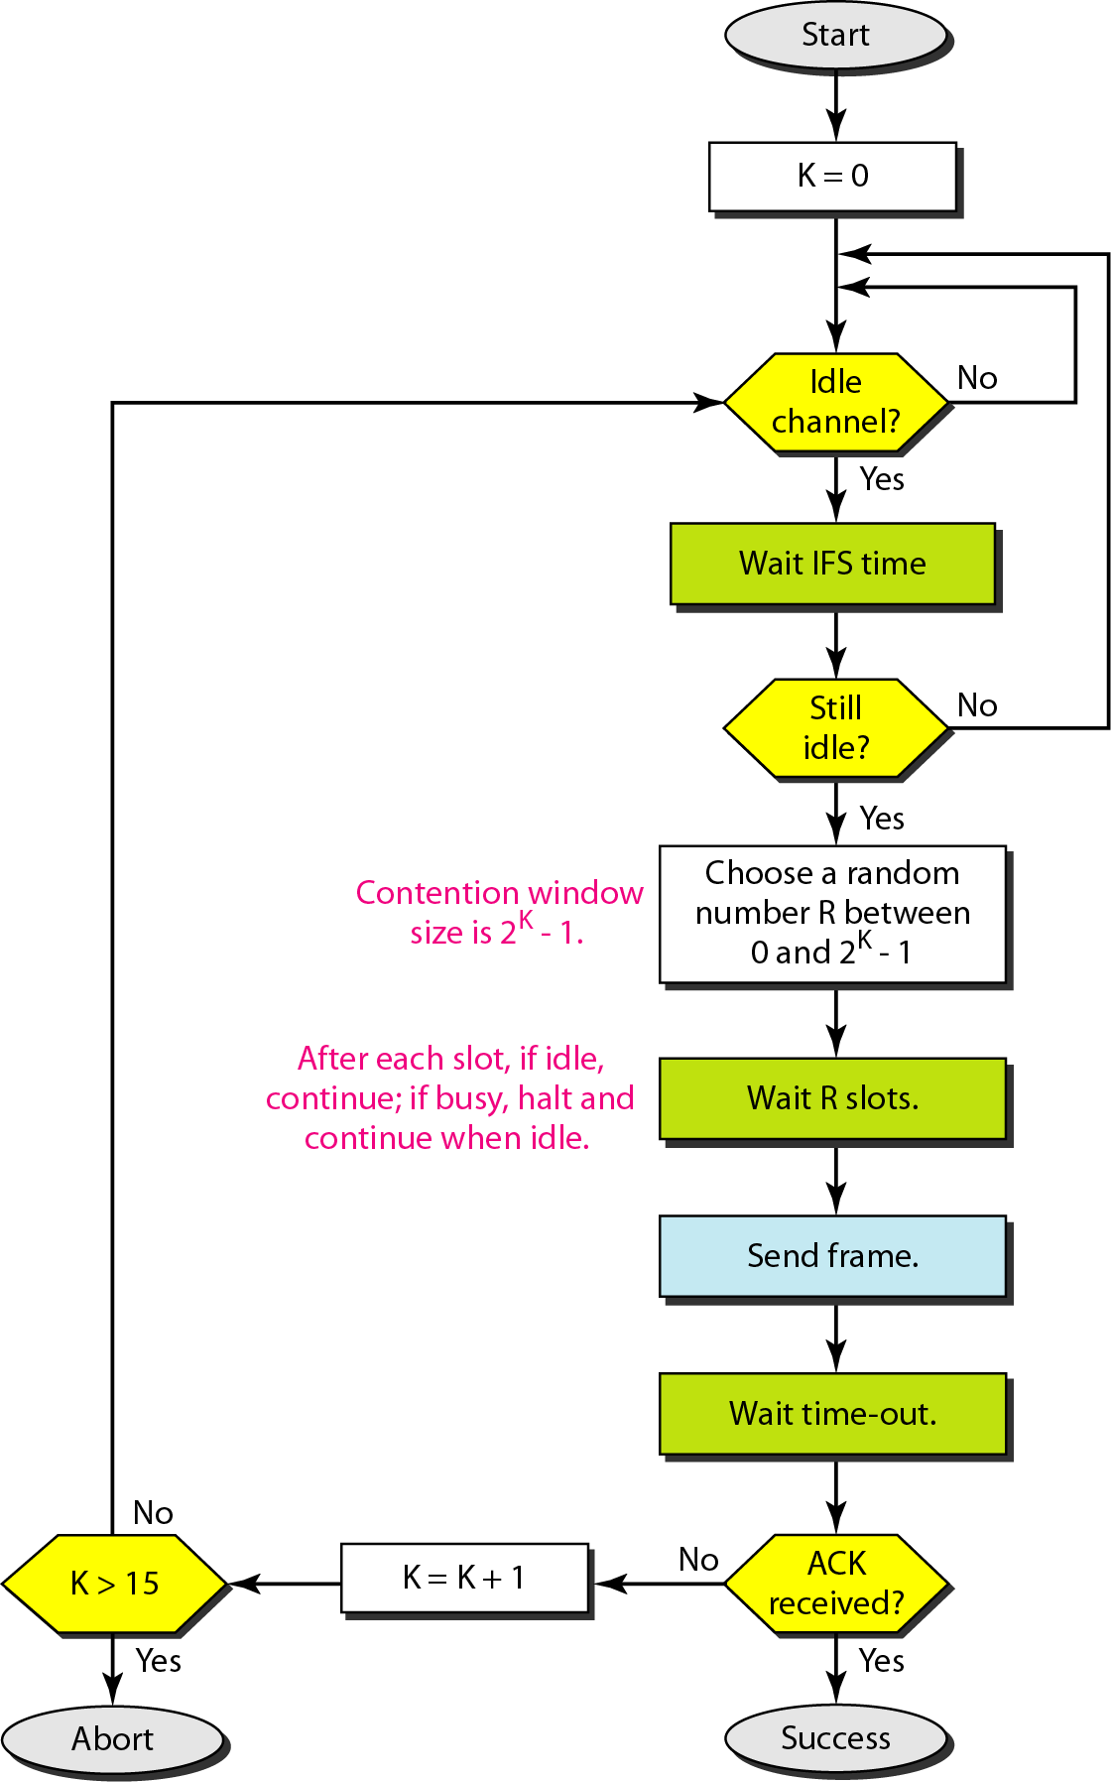
CSMA/CA

Slide 40
Controlled access
the stations consult one another to find which station has the right to send.
A station cannot send unless it has been authorized by other stations.
Methods
Reservation
Polling
Token Passing

Slide 41
Reservation
In the reservation method, a station needs to make a reservation before sending data.
The time line has two kinds of periods:
Reservation interval of fixed time length
Data transmission period of variable frames.
If there are M stations, the reservation interval is divided into M slots, and each station has one slot.
Suppose if station 1 has a frame to send, it transmits 1 bit during the slot 1. No other station is allowed to transmit during this slot.
In general, i ^{th} station may announce that it has a frame to send by inserting a 1 bit into i ^{th} slot. After all N slots have been checked, each station knows which stations wish to transmit.

Slide 42
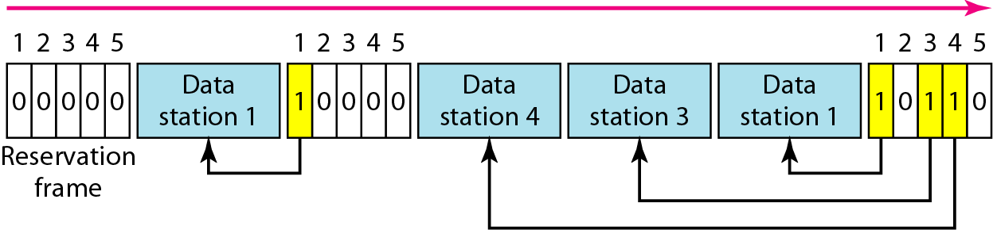
Reservation
The stations which have reserved their slots transfer their frames in that order.
After data transmission period, next reservation interval begins.
Since everyone agrees on who goes next, there will never be any collisions.

Slide 43
Polling
Polling process is similar to the roll-call performed in class. Just like the teacher, a controller sends a message to each node in turn.
In this, one acts as a primary station(controller) and the others are secondary stations. All data exchanges must be made through the controller.
The message sent by the controller contains the address of the node being selected for granting access.
Although all nodes receive the message but the addressed one responds to it and sends data, if any. If there is no data, usually a “poll reject”(NAK) message is sent back.
Problems include high overhead of the polling messages and high dependence on the reliability of the controller.

Slide 44
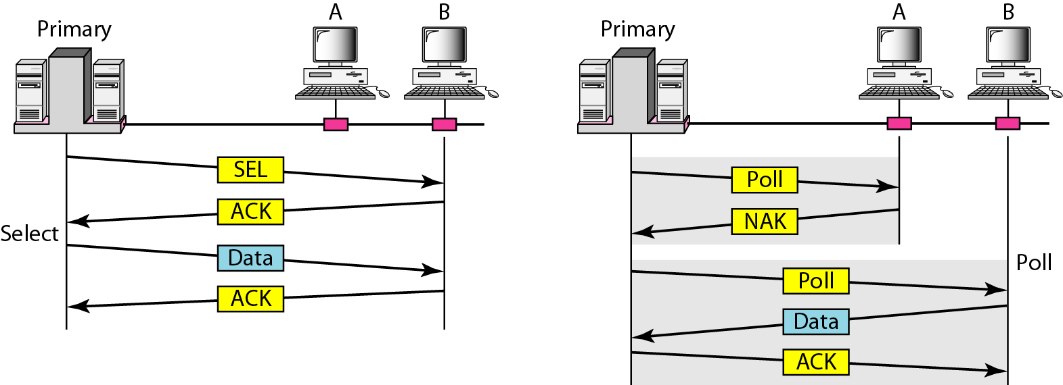
Polling

Slide 45
Token passing
In token passing scheme, the stations are connected logically to each other in form of ring and access of stations is governed by tokens.
A token is a special bit pattern or a small message, which circulate from one station to the next in the some predefined order.
In Token ring, token is passed from one station to another adjacent station in the ring whereas incase of Token bus, each station uses the bus to send the token to the next station in some predefined order.
In both cases, token represents permission to send. If a station has a frame queued for transmission when it receives the token, it can send that frame before it passes the token to the next station. If it has no queued frame, it passes the token simply.

Slide 46
Token passing
After sending a frame, each station must wait for all N stations (including itself) to send the token to their neighbors and the other N – 1 stations to send a frame, if they have one.
There exists problems like duplication of token or token is lost or insertion of new station, removal of a station, which need be tackled for correct and reliable operation of this scheme.

Slide 47
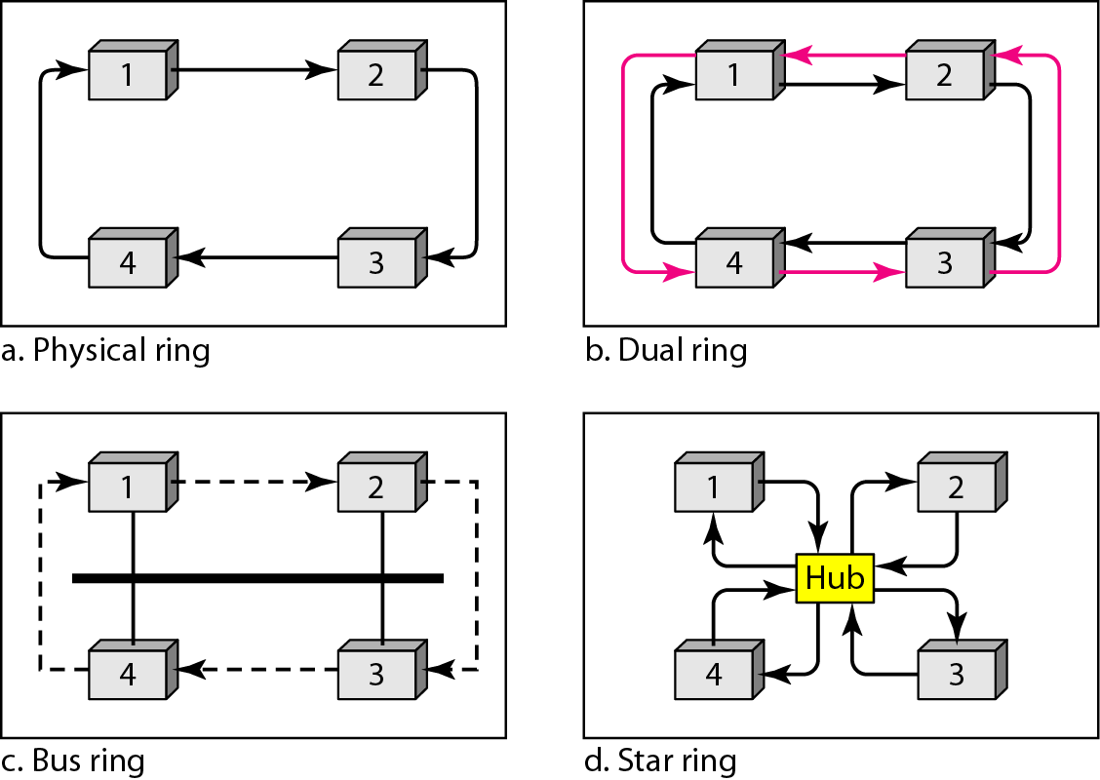
Token ring

Slide 48
Protocols(CO3)
Topic objective
Understand the protocols used in Data link layer
Understand the Noisy and noiseless channels
Implement the error detection and error correction
Recap of previous topic
MAC gives access to multiple channels
Channel is allocated based on static or dynamic
Multiple Access protocols are used to allocate channels

Slide 49
Protocols(CO3)
Protocols in the data link layer are designed so that this layer can perform its basic functions:
Framing - process of dividing bit - streams from physical layer into data frames whose size ranges from a few hundred to a few thousand bytes
error control - transmission errors and retransmission of corrupted and lost frames
flow control - regulates speed of delivery and so that a fast sender does not drown a slow receiver.

Slide 50
Protocols
Data Link Protocols
Noiseless Channels
Noisy Channels
Simplex
Stop – and – wait
Stop – and – wait ARQ
Go-Back- N ARQ
Selective Repeat ARQ

Slide 51
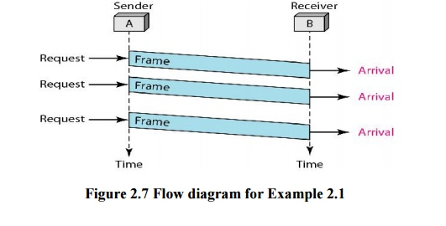
For Noiseless channels
Simplex Protocol
unidirectional data transmission over an ideal channel
It has distinct procedures for sender and receiver.
The sender simply sends all its data available onto the channel as soon as they are available its buffer.
The receiver is assumed to process all incoming data instantly.

Slide 52
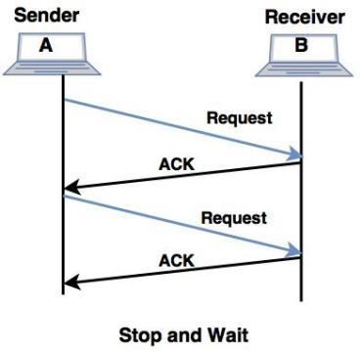
For Noiseless channels
Stop – and – Wait Protocol
unidirectional data transmission without any error control facilities
flow control so that a fast sender does not drown a slow receiver.
The receiver has a finite buffer size with finite processing speed.
The sender can send a frame only when it has received indication from the receiver that it is available for further data processing.

Slide 53
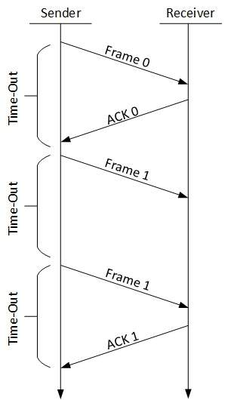
For Noisy Channels
Stop – and – Wait ARQ (Automatic Repeat Request)
with added error control mechanisms
The sender keeps a copy of the sent frame.
It then waits for a finite time to receive a positive acknowledgement from receiver.
If the timer expires or a negative acknowledgement is received, the frame is retransmitted.
If a positive acknowledgement is received then the next frame is sent.

Slide 54
For Noisy Channels
Go – Back – N ARQ
sending multiple frames before receiving the acknowledgement for the first frame.
It uses the concept of sliding window, and so is also called sliding window protocol.
The frames are sequentially numbered and a finite number of frames are sent.
If the acknowledgement of a frame is not received within the time period, all frames starting from that frame are retransmitted.
Reason for retransmission
Damaged frame
Lost data frame
Lost Acknowledgement

Slide 55
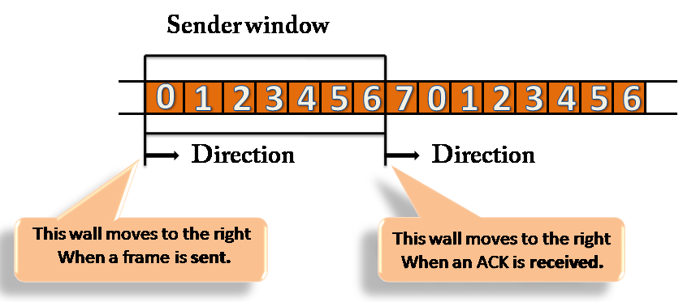
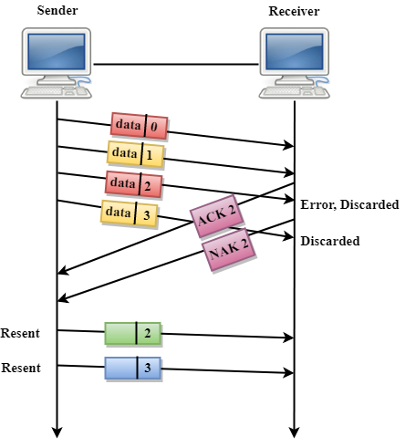
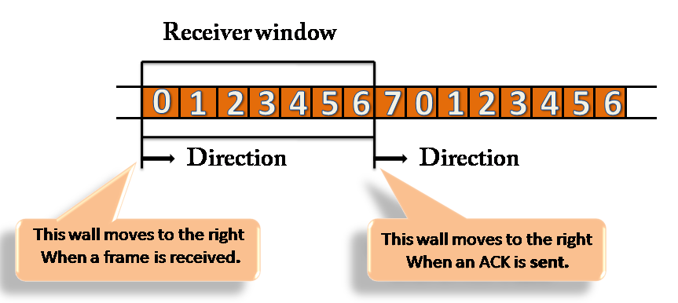
For Noisy Channels
Go – Back – N ARQ

Slide 56
For Noisy Channels
Piggy backing Technique
there is a need for transmitting data in both directions between 2 computers.
A full duplex circuit is required for the operation.
the data frames and ACK (control) frames in the reverse direction have to be interleaved.
An efficient method is to absorb the ACK frame into the header of the data frame going in the same direction. This technique is known as piggybacking.
When a data frame arrives at an IMP (receiver or station), instead of immediately sending a separate ACK frame, the IMP restrains itself and waits until the host passes it the next message.
The acknowledgement is then attached to the outgoing data frame using the ACK field in the frame header.

Slide 57
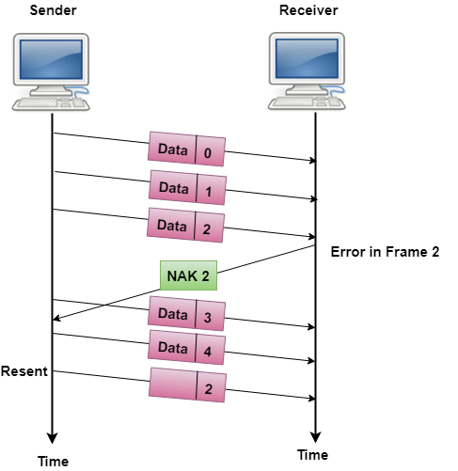
For Noisy Channels
Selective Repeat ARQ
sending multiple frames before receiving the acknowledgement for the first frame.
only the erroneous or lost frames are retransmitted, while the good frames are received and buffered.

Slide 58
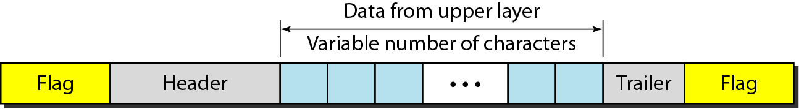
Data Link Layer(CO5)
The data link layer needs to pack bits into frames, so that each frame is distinguishable from another.
The three main functions of the data link layer are
to deal with transmission errors,
regulate the flow of data, and
provide a well-defined interface to the network layer
Design issues -Error Control
Dealing with transmission errors.
Sending acknowledgement frames in reliable connections.
Retransmitting lost frames.
Identifying duplicate frames and deleting them.
Controlling access to shared channels in case of broadcasting.

Slide 59
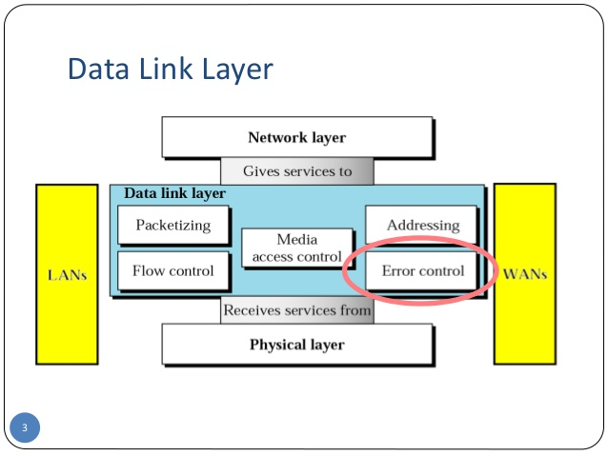
Error Control

Slide 60
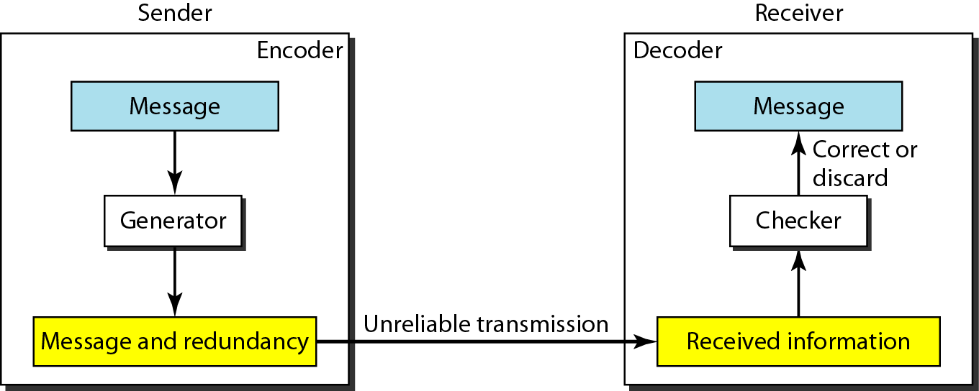
Error detection and correction
Data can be corrupted during transmission
Types of error
Bit error
Burst error
To detect or correct errors, we need to send extra (redundant) bits with data.

Slide 61
Error detection and correction
An error-detecting code can detect only the types of errors for which it is designed; other types of errors may remain undetected.
Byte stuffing is the process of adding 1 extra byte whenever there is a flag or escape character in the text.
Bit stuffing is the process of adding one extra 0 whenever five consecutive 1s follow a 0 in the data

Slide 62
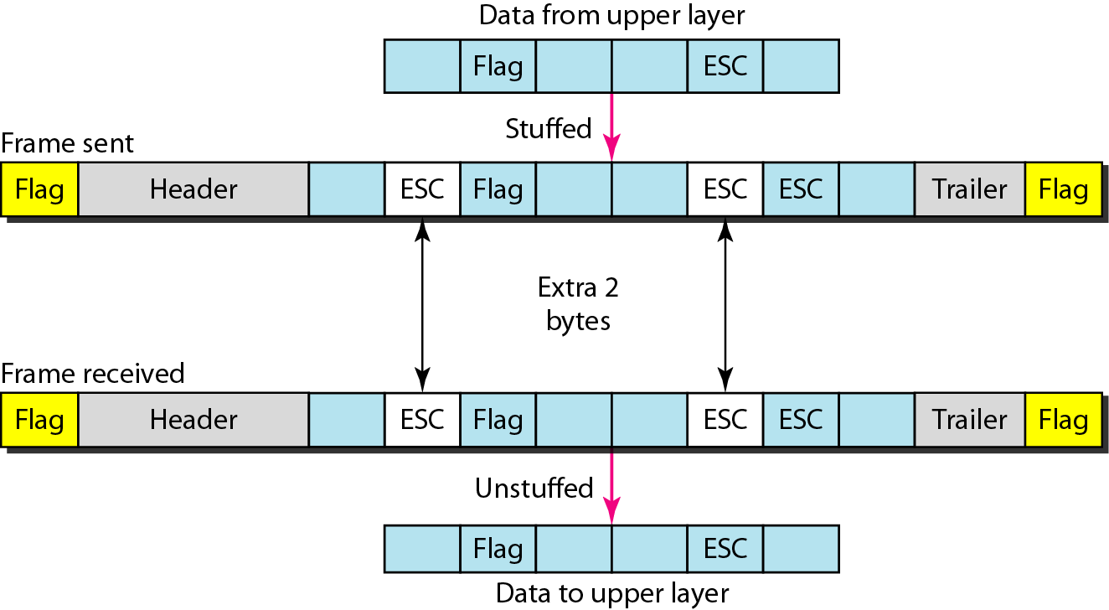
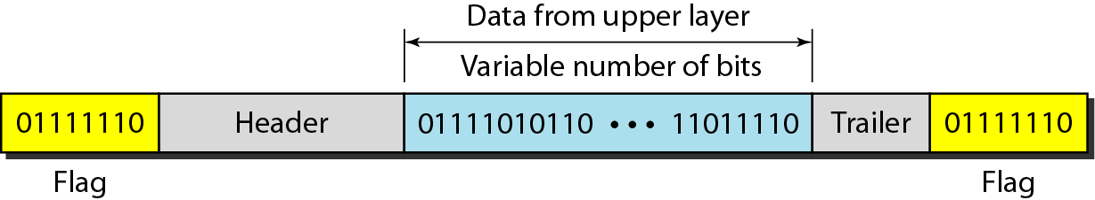
Byte stuffing & bit stuffing(CO4)

Slide 63
Error Control
Error control
Error Detection
Error Correction
Parity hamming distance
Checksum
CRC

Slide 64
Error Detection(CO5)
Parity checks
For a data of n size add a parity bit
Even parity
Odd parity
For example if a data to be send is 1110001
Then for even parity the bit will be 0
for odd parity the bit will be 1
How many bit errors it can detect?
Suppose 10001110 is transmitted received as 10011110 -------error detected
But if 10001110 is transmitted received as 10010110 --------no error detected

Slide 65
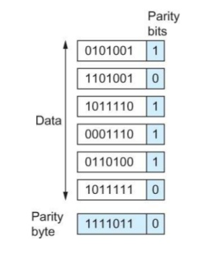
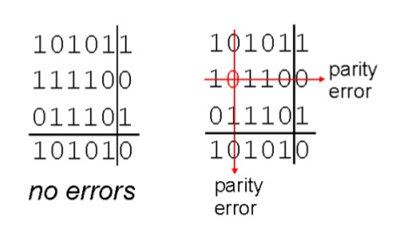
Error Detection
Two dimensional parity checks

Slide 66
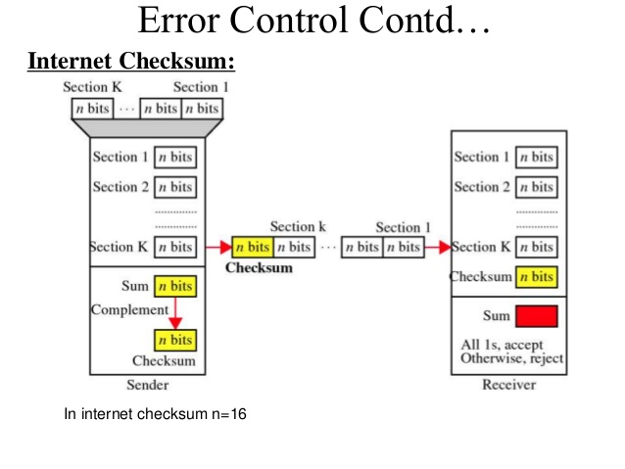
Error Detection
Checksum

Slide 67
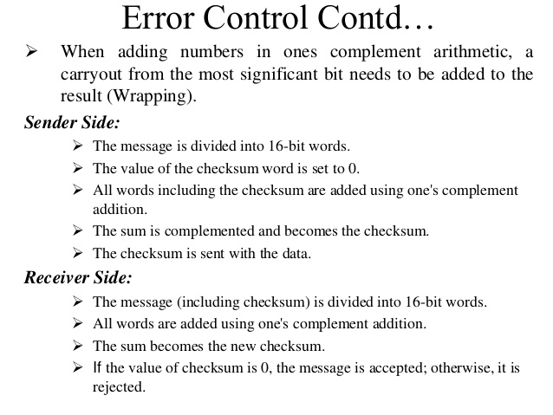
Error Detection
Checksum

Slide 68
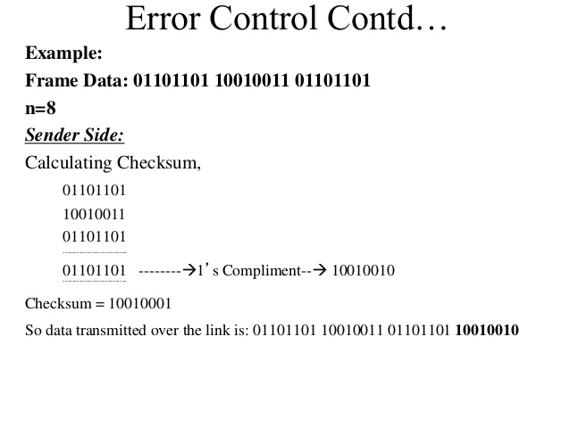
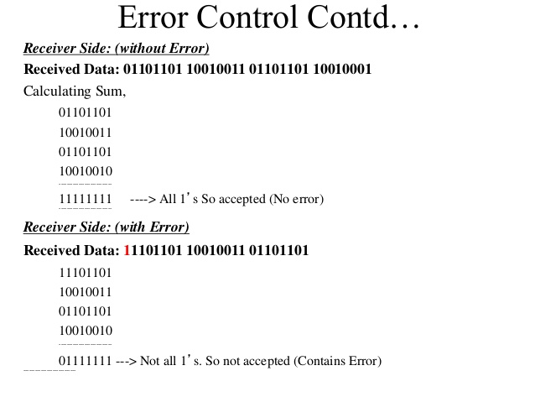
Error Detection
Checksum

Slide 69
Error Detection
Cyclic Redundancy check (CRC)
Packet of data transmitted as a polynomial 1101 = x^3+x^2+1
At sender end - the polynomial is divided by the given generating polynomial
Remainder is attached to the end of the message
Quotient is discarded
Message is transmitted
Receiver divides the message with same polynomial
If remainder not equal to zero then error occurred
Else equal to zero then no error

Slide 70
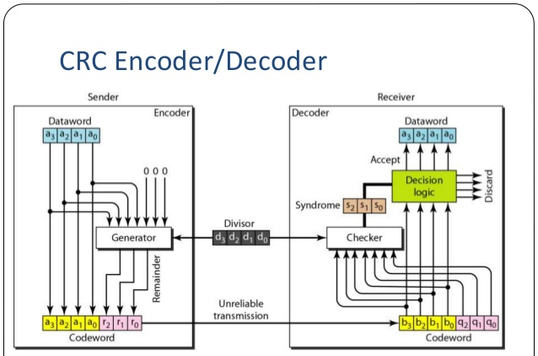
Error Detection

Slide 71
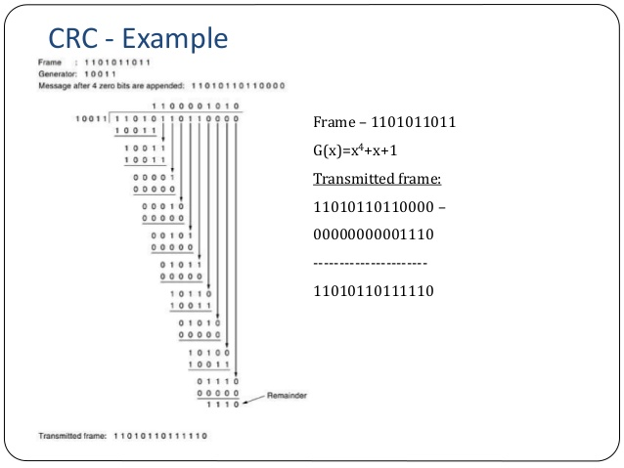
Error Detection
K= 11010110110000
N= 10011
C = k+n-1 =14
Remainder = 1110
11010110110000
1110
Codeword =11010110111110
N = 10011

Slide 72
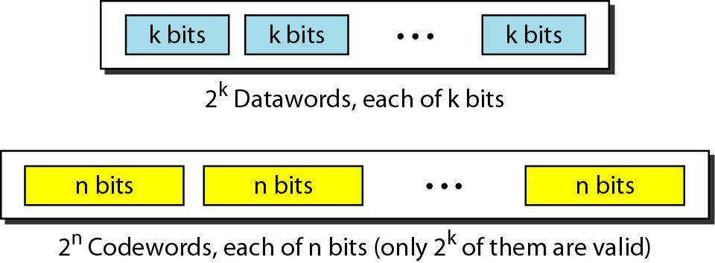
Error Correction
Block coding
In block coding, we divide our message into blocks, each of k bits, called datawords.
We add r redundant bits to each block to make the length n = k + r.
The resulting n-bit blocks are called codewords.

Slide 73
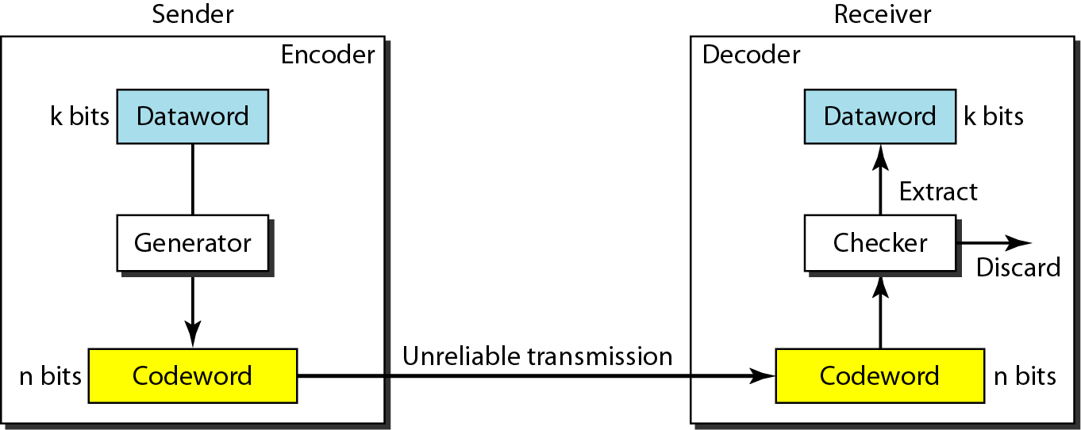
Error Correction
Block coding

Slide 74
Error Correction
Hamming distance
The Hamming distance between two words is the number of differences between corresponding bits.
The minimum Hamming distance is the smallest Hamming distance between all possible pairs in a set of words.
To guarantee the detection of up to s errors in all cases, the minimum Hamming distance in a block code must be d_{min} = s + 1.
To guarantee correction of up to t errors in all cases, the minimum Hamming distance in a block code must be d_{min} = 2t + 1.

Slide 75
Error Correction
Hamming distance
The Hamming distance d(000,011) is 2
000 XOR 011 is 011
Similarly for designing a code minimum hamming distance is used
Which is the smallest hamming distance between all possible pairs
Ex 1. For d(000,011)=2 d(000,101) =2 d(000,110) =2 d(011,101)=2
d(011,110) =2 d(101,110)=2
Ex. For d(00000,01011)= 3 d(00000,10101) =3 d(00000,11110)=4
Error detected =3
Error corrected =2

Slide 76
IEEE Standards(CO2)
Topic objective
Understand the IEEE standards
Various standard designed for IEEE
Recap of previous topic
What are protocols?
Protocols used for data link layer
Implement error detection and correction code

Slide 77
IEEE Standards(CO2)
In 1985 The Computer society started a project called Project 802
Enable intercommunication among various devices
Specify functions of physical layer and data link layer of LAN protocols
Various IEEE 802 standards are as
IEEE 802.1 High Level Interface
IEEE 802.2 Logical Link Control(LLC)
IEEE 802.3 Ethernet
IEEE 802.4 Token Bus
IEEE 802.5 Token Ring
IEEE 802.6 Metropolitan Area Networks
IEEE 802.7 Broadband LANs
IEEE 802.8 Fiber Optic LANS
IEEE 802.9 Integrated Data and Voice Network
IEEE 802.10 Security
IEEE 802.11 Wireless Network

Slide 78
IEEE Standards
802.2 Logical Link Control
"the standard for the upper Data Link Layer sublayer also known as the Logical Link Control layer. It is used with the 802.3, 802.4, and 802.5 standards (lower DL sublayers).“
specifies the general interface between the network layer (IP, IPX, etc) and the data link layer (Ethernet, Token Ring, etc).
It is responsible for flow and error control.

Slide 79
IEEE Standards
802.3 Ethernet
standard for CSMA/CD (Carrier Sense Multiple Access with Collision Detection).
This standard encompasses both the MAC and Physical Layer standards.If there is no data, any node may attempt to transmit, if the nodes detect a collision, both stop transmitting and wait a random amount of time before retransmitting the data.
The original 802.3 standard is 10 Mbps (Megabits per second). 802.3u defined the 100 Mbps (Fast Ethernet) standard, 802.3z/802.3ab defined 1000 Mbps Gigabit Ethernet, and 802.3ae define 10 Gigabit Ethernet.
Commonly, Ethernet networks transmit data in packets, or small bits of information.
A packet can be a minimum size of 72 bytes or a maximum of 1518 bytes.

Slide 80
IEEE Standards
802.4 Token Bus
Token bus standards as broadband computer networks
Logically, the stations are organized into a ring
When the logical ring is initialized, the highest numbered station may send the first frame. The token and frames of data are passed from one station to another following the numeric sequence of the station addresses.
The token does not follow the physical ordering of workstation attachment to the cable,there is no collision as only one station possesses a token at any given time.

Slide 81
IEEE Standards
802.5 Token Ring
designed to use the ring topology and utilizes a token to control the transmission of data on the network.
The token is a special frame which is designed to travel from node to node around the ring. When it does not have any data attached to it, a node on the network can modify the frame, attach its data and transmit. Each node on the network checks the token as it passes to see if the data is intended for that node, if it is; it accepts the data and transmits a new token. If it is not intended for that node, it retransmits the token on to the next node.

Slide 82
IEEE Standard
FDDI (Fiber Distributed Data Interface)
a set of ANSI and ISO standards for data transmission on fiber optic lines in a local area network (LAN) that can extend in range up to 200 km (124 miles). The FDDI protocol is based on the token ring protocol
An FDDI network contains two token rings, one for possible backup in case the primary ring fails.

Slide 83
IEEE Standard
The FDDI data frame format is:
Where
PA is the preamble,
SD is a start delimiter,
FC is frame control,
DA is the destination address, SA is the source address,
PDU is the protocol data unit (or packet data unit),
FCS is the frame check Sequence (or checksum), and
ED/FS are the end delimiter and frame status.
PA | SD | FC | DA | SA | PDU | FCS | ED/FS
16 bits | 8 bits | 8 bits | 48 bits | 48 bits | up to 4478×8 bits | 32 bits | 16 bits

Slide 84
IEEE Standards
802.11 Wireless Network Standards
collection of standards setup for wireless networking.
the three popular standards: 802.11a, 802.11b, 802.11g and latest one is 802.11n.
Each standard uses a frequency to connect to the network and has a defined upper limit for data transfer speeds.
802.11a was one of the first wireless standards.
802.11b standard was popular due to higher prices and lower range.
802.11g is a standard operates in the same band as 802.11b, 802.11g is compatible with 802.11b equipment.
Wireless LANs primarily use CSMA/CA - Carrier Sense Multiple Access/Collision Avoidance. It has a "listen before talk" method of minimizing collisions on the wireless network.
This results in less need for retransmitting data.

Slide 85
Glossary questions
_________ address is a unique identifier allotted to a NIC of a device.
Full form of NIC is ___________
The latest standard of 802.11 is _______
The full form of PDU is _________
The standard for the upper Data Link Layer sublayer also known as the ________
The ________between two words is the number of differences between corresponding bits.
Slotted Aloha need central clock for ________
__________regulates speed of delivery and so that a fast sender does not drown a slow receiver

Slide 86
Weekly Assignment
1. How will you find out how many Hamming code bits should be incorporated? CO2
2.For the given data using bit stuffing method. How data will be sent?
011011111011111101111101111111011 CO2
3. Find out the LRC & VRC for the below characters? CO2
0 0 1 1 0 1
1 1 0 1 0 0
0 1 1 0 1 0
0 0 1 0 1 1
4.For the data given below : how it will be sent using character stuffing method? CO2
abcdefghijka DLE 123456789RAMARAO DLE
5.Prove that the channel utilization is 18% in ALOHA and 37% slotted ALOHA. CO2

Slide 87
Weekly Assignment
6. Given the dataword 101001111 and the divisor 10111, show the generation of the CRC codeword at the sender site. CO2
7. A sender has two data items to send (4567)₁₆ and (BA98)₁₆. What is the value of the checksum? CO2
8. Assuming even parity, find the parity bit for each of the following given data CO2
i. 1001011 ii. 0001100 iii. 1000000 iv. 1110111
9. Assume we need to create codewords that can automatically correct a one-bit error. What should the number of redundant bits ( r) be, given the number of bits in the dataword (k)? Remember that the codeword needs to be n = k+r bits, called C(n,k). After finding the relationship, find the number of bits in r if k is 1,2,5,50 or 1000 CO2
10. Explain the different IEEE formats. CO2

Slide 88
MCQ
IEEE standard for Wireless LANs is 802.5 802.8 802.11 802.12
2. The full form of CRC is Cyclic redundancy check Cyclic repetitive check Check redundancy code D. Check redundancy cycle

Slide 89
MCQ
3. The error correcting and detecting properties of a code depends on its Distance Hamming distance Lambda Parity bit
4. Which layer changes the sequence of bits into electromagnetic signals Session layer Network layer Data link layer Physical Layer

Slide 90
MCQ
5. __________ is explained as unsynchronized transmission at any instant Pure Aloha Slotted Aloha CSMA CSMA/CD
6. If byte stuffing is used for a data fragment A ESC FLAG B, then output after stuffing will be ESC A ESC FLAG B A ESC ESC FLAG B A ESC ESC ESC FLAG B A ESC FLAG B ESC

Slide 91
MCQ
7. Which layer changes the sequence of bits into electromagnetic signals Session layer Network layer Data link layer Physical Layer
8. _____ are based on treating bit strings as representation of polynomials with coefficients of 0 and 1 only Polynomial code CRC Both A & B None

Slide 92
Faculty Video Links, Youtube & NPTEL Video Links and Online Courses Details
Youtube/other Video Links
https://www.youtube.com/watch?v=xmMcfwbWaHk
https://www.youtube.com/watch?v=IftFvfSywCQ

Slide 93
Old Question Papers
18-19
https://drive.google.com/open?id=17OUMNnX0kFDc9UB8tx8qd8zyEj7lCD5P
17-18
https://drive.google.com/open?id=1oFmw__qC7wdUP85gUkKbkohZvd9Vopm_
16-17
https://drive.google.com/open?id=1eDrOkj2wVsxdTZPb7-A78YuYn16HC1ob
15-16
https://drive.google.com/open?id=1ljNxmZP1_pl10rbxJvK6xB1ybG7AMuqU
14-15
https://drive.google.com/open?id=1tjERKPwEA9icWcQTBZQnKUq_ttqBDeo5

Slide 94
Expected Questions for University Exam
What is the function of Data Link Layer. CO2
What is piggybacking? CO2
What are the different types of Ethernet available. CO2
Draw the frame format of MAC CO2
Explain CSMA/CA and CSMA/CD with suitable diagram CO2

Slide 95
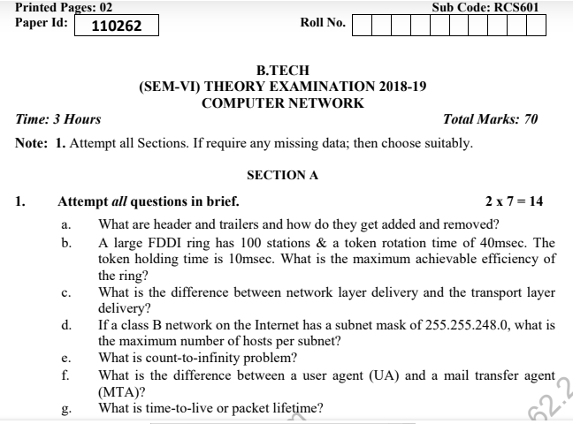
Question paper of University Exam

Slide 96
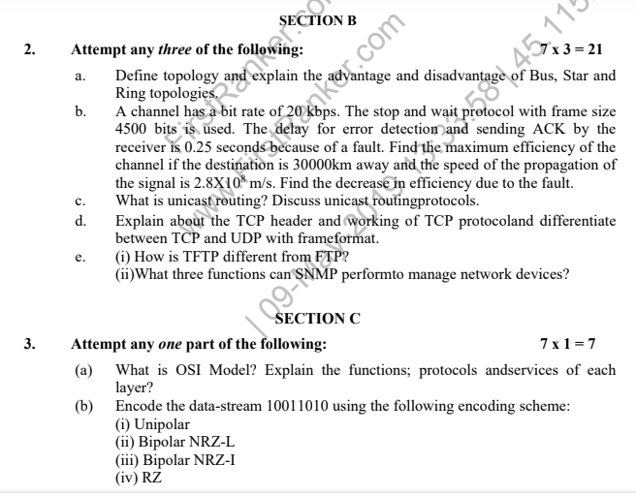
Question paper of University Exam

Slide 97
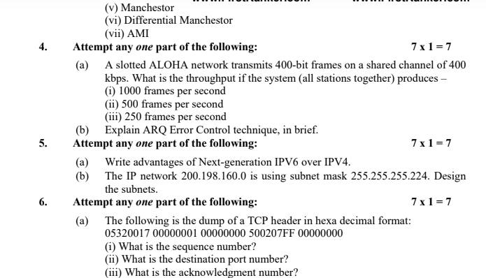
Question paper of University Exam

Slide 98
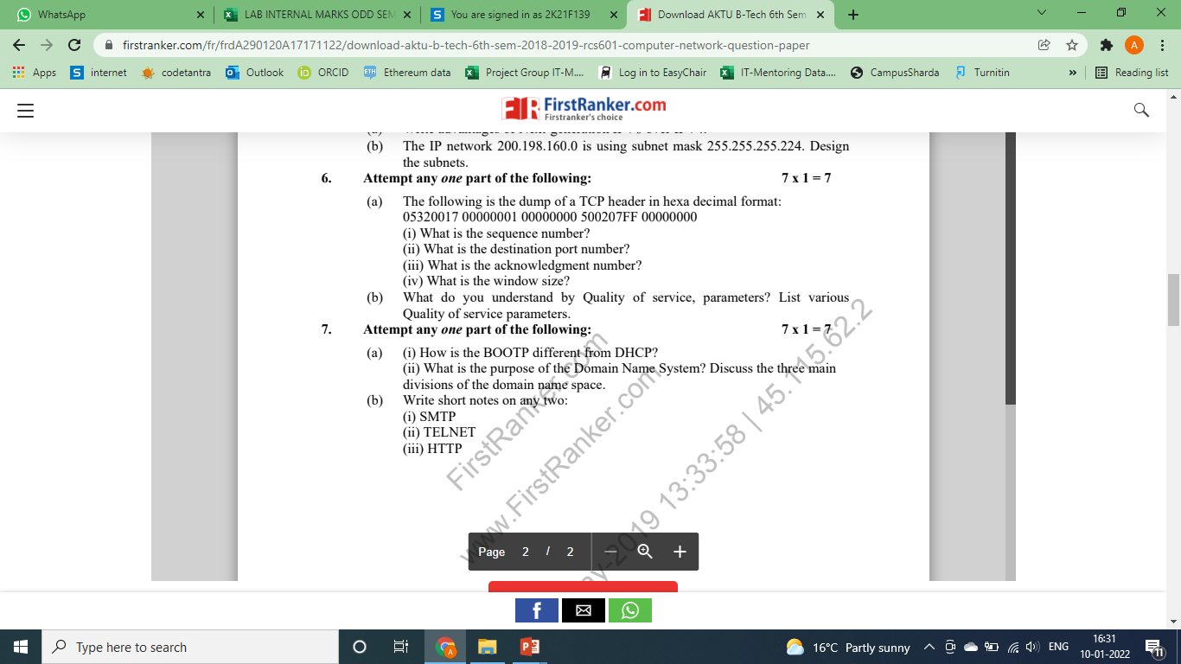
Question paper of University Exam

Slide 99
Summary
Channel Allocations Dynamic and static
Various LAN Protocols – including ALOHA protocols
Overview of IEEE standards - FDDI.
Data Link Layer – various Elementary Data Link Protocols
Error Handling using correction and detection.

Slide 100
Text Books
Behrouz Forouzan, “Data Communication and Networking”, McGraw Hill
2. Andrew Tanenbaum “Computer Networks”, Prentice Hall.
3. William Stallings, “Data and Computer Communication”, Pearson.

Slide 101
References
1. Forouzen, "Data Communication and Networking", TMH
2. A.S. Tanenbaum, Computer Networks, Pearson Education
3. W. Stallings, Data and Computer Communication, Macmillan Press
4. Gary R.Wright,W.Richard Stevens "TCP/IP Illustrated,Volume2 The Implementation" Addison-Wesley
5. Michael A. Gallo and William M. Hancock "Computer communucation and Networking Technology" Cengage Learning
6. Bhavneet Sidhu, An Integrated approach to Computer Networks, Khanna Publishing House
7. Anuranjan Misra, “Computer Networks”, Acme Learning
8. G. Shanmugarathinam, ”Essential of TCP/ IP”, Firewall Media

Slide 102
Noida Institute of Engineering and Technology, Greater Noida
Thank You

